Slide 1

PROJECT PROPOSAL
PRESENTED BY:
ODERA DICKENS OCHIENG
COM/B/01-02204/2016

Slide 2
PLANTEX
PROJECT TITLE

Slide 3
ABSTRACT
Plantex is an android application based on artificial intelligence that examines a maize crop’s health by determining the type of disease affecting it and performs possible diagnosis on the identified disease.
The front end functionality is a smart phone’s front camera that the farmer or the agronomist uses to take pictures of the leaves of the maize crops.
The back end is driven by a machine learning model that is pre-trained to identify and classify whether the supplied image of the maize crop is healthy or not, and if unhealthy, it identifies the type of the disease affecting the leaf giving possible diagnosis for the same

Slide 4
BACKGROUND INFORMATION
Maize is the staple food for many families in Kenya and is consumed by 80 % of the population of Kenya.
It is produced in most regions in Kenya, including areas where it is not suited.

Slide 5
PROBLEM STATEMENT
Maize farmers in Kenya, either large scale or small scale, often undergo loses due to disease infestation on their maize fields. There is limited technological enhancements to enable these farmers perform periodic diagnosis of the maize crops without seeking the assistance of paid agricultural consultancies and agronomists.

Slide 6
PROBLEM JUSTIFICATION
The mobile application will enable the maize farmers take pictures of the maize leaves, perform diagnosis on the maize crop and in turn get possible solutions as feedback from the application in regard to the identified disease.

Slide 7
OBJECTIVES
MAIN OBJECTIVE
SPECIFIC OBJECTIVES
To enable maize farmers perform periodic diagnosis on their crops and get feedback without necessarily visiting paid agricultural consultancies and agronomists.
Maize disease identification
Maize disease classification
Maize disease diagnosis

Slide 8
SCOPE
Plantex is an android application that is not only limited to maize farmers but its usage also extends to the agronomists and agricultural researchers.

Slide 9
BENEFICIARIES
Maize farmers in Kenya
Agronomists

Slide 10
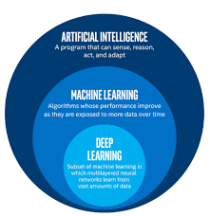
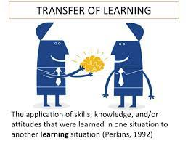
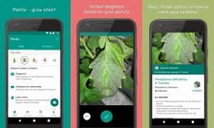
PROJECT METHODOLOGY
Machine Learning
Transfer Learning
Android Development
The project uses deep learning, a specific approach for building and training neural networks, which are considered highly performing decision-making nodes.
The project uses pre-trained AlexNet model, re-trains it for the maize disease identification and classification.
It uses android programming language for the user interface and processing of the diagnosis in regard to the deep-learning model at the back end.

Slide 11
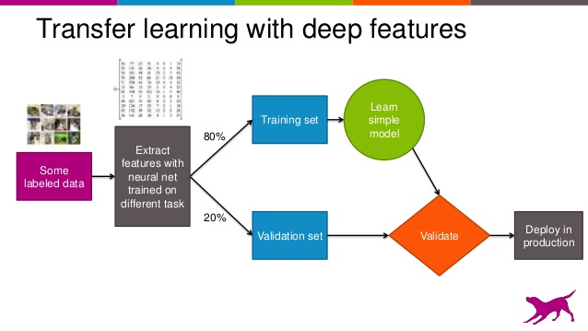
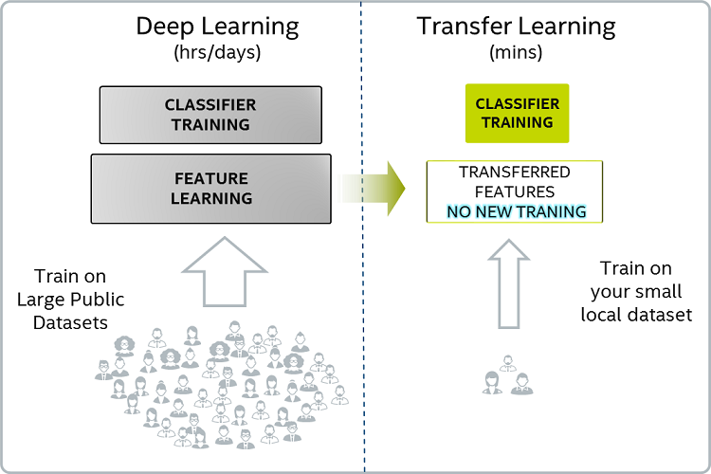
TRANSFER LEARNING
Why transfer learning?

Slide 12
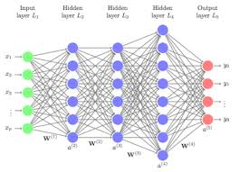
THE ALGORITHM
The project uses Convolutional Neural Networks, a Deep Learning Algorithm which can take in an input image, assign importance( learnable weights and biases) to various aspects/objects in the image and be able to differentiate one from the other.

Slide 13
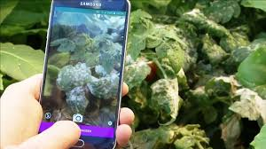
USE CASE DIAGRAM
The images are then fed into the CNN algorithm as input
A farmer uses the android device to take images of the maize leaves
Image recognition and deep learning process to identify features in the maize leaves.
The farmer gets the feedback on clicking a diagnose button
The process is repeated for any new set images

Slide 14
REQUIREMENTS
Software
Hardware
Functional
Laptop
Android device
Maize leaves dataset
Maize disease dataset
Taking pictures
Diagnosis (pressing a button)
Python 3.7 or 2.7
Anaconda
Java Virtual Machine
Android Studio 3
Ubuntu TLS 16 or 18
AlexNet model
Non functional
Performance
Reliability

Slide 15
EXISTING SOLUTION

Slide 16
COMPARISON OF THE TWO SOLUTIONS

Slide 17
PROJECT SCHEDULE
ACTIVITY | WEEK
 | 1 | 2 | 3 | 4 | 5 | 6 | 7 | 8 | 9 | 10 | 11 | 12 | 13 | 14
Project identification
Requirements analysis
System design
System development
Testing
Documentation

Slide 18
PROJECT BUDGET
ITEM | AMOUNT(KSH.)
Laptop | 35000
Android smart phone | 15000
Internet for downloading datasets | 1000
Total | 51000

Slide 19
REFERENCES
1. https://www.researchgate.net/plant-disease-classification
2.
3.
4. https://www.kalro.org
5. http://www.hdl.handle.net/11
6. https://www.techopedia.com/definition/30325/deep-learning
7. https://www.towardsdatascience.com/a-comprehensive-guide-to-convolutional-neural-networks-the-elif5-way-3bd2b1164a53
https://www.blog.invasive-species.org
https://www.science-direct.com

Slide 20
END THANK YOU

